Slide 1

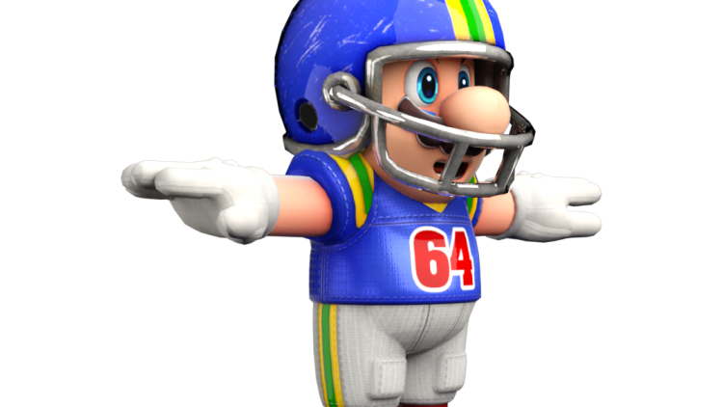

Football V
Produced by Dr. Mario | UNC STOR 538

Slide 2
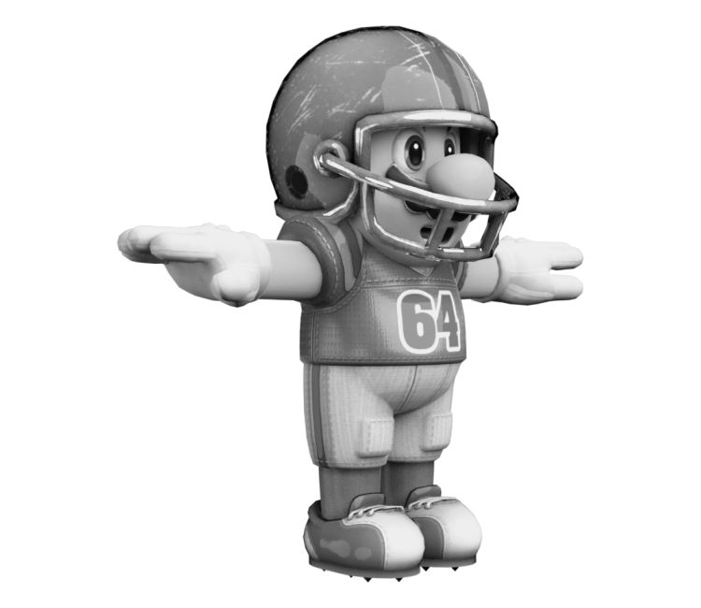
Why Don’t Teams Always Pass?
Passing Plays Seem to Dominate Running Plays
Simple Model of Play Selection
Offensive Choice: Run or Pass
Defensive Choice: Defend Run or Defend Pass
Consider the Payoff Matrix
Offense Gains 1 Yard = Defense Loses 1 Yard
Positive = Good For Offense
 | Run Defense | Pass Defense
Offense Runs | -5 | 5
Offense Passes | 10 | 0

Slide 3
Why Don’t Teams Always Pass?
James von Neumann and Oskar Morgenstern
Foundation of Game Theory (1944)
Built From Mathematics and Economics
Two-Person Zero Sum Games = Games Where 2 Players are In Total Conflict
Assumption 1: Row Player Wants to Maximize the Payoff
Assumption 2: Column Player Wants to Minimize the Payoff
Payoff Matrix Applied to Offense Decisions
Suppose the Offense Passes Every Time
Defense Could Defend Passing Every Time
Offense Would Gain 0 Yards
Is There an Optimal Mixed Strategy for the Offense?

Slide 4



Why Don’t Teams Always Pass?
Mixed Strategy
Let $p$ Represent the Probability Offense Runs
Suppose Run Defense is Chosen
Suppose Pass Defense is Chosen
Suppose Offense Runs 75% of the Time
Suppose Offense Runs 25% of the Time
$$E\left[Gain | Run Defense\right]=p\left(−5\right)+\left(1−p\right)10=−15p+10$$
$$E\left[Gain | Pass Defense\right]=p\left(5\right)+\left(1−p\right)0=5p$$
$$E\left[Gain | Run Defense\right]=−1.25$$
$$E\left[Gain | Pass Defense\right]=3.75$$
Always Run Defense
$$E\left[Gain | Run Defense\right]=6.25$$
$$E\left[Gain | Pass Defense\right]=1.25$$
Always Pass Defense

Slide 5
Why Don’t Teams Always Pass?
Optimal Strategy for Offense
Balancing the Expected Gain
Offense Runs 50% of the Time = Defense Has No Optimal Strategy
No Matter What Defense Selects Expected Gain is 2.5 Yards
Value to the Offense (Row Player) is 2.5 Yards
$$E\left[Gain | Run Defense\right]=−15p+10=5p=E[Gain|Pass Defense]$$
$$−20p=−10$$
$$p=0.5$$

Slide 6
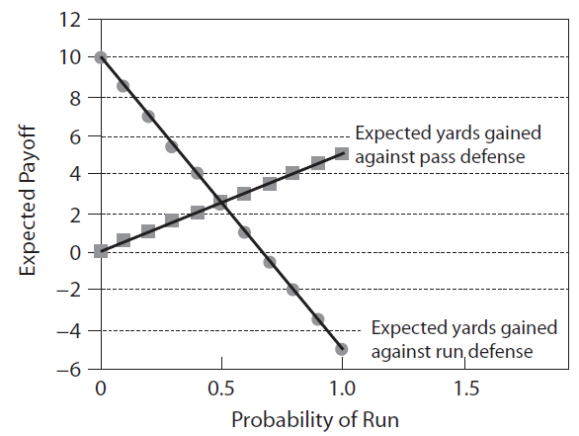
Why Don’t Teams Always Pass?
Optimal Strategy for Offense
Visualization

Slide 7
Why Don’t Teams Always Pass?
Interesting Conclusion
Recall the Payoff Matrix
Defense Guesses Correctly = Passing is 5 Yards Better
Defense Guesses Incorrectly = Passing is 5 Yards Better
Passing Seems to Dominate
Optimal Strategy is to Mix Up Offense and Defense
Problems or Ideas?
 | Run Defense | Pass Defense
Offense Runs | -5 | 5
Offense Passes | 10 | 0

Slide 8
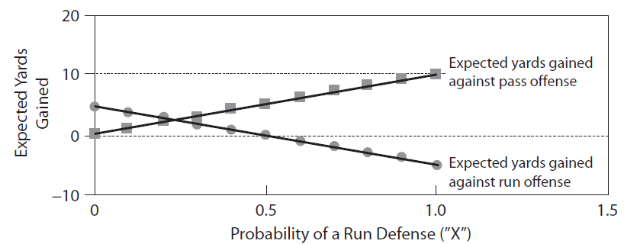

Why Don’t Teams Always Pass?
Optimal Strategy for Defense
Let $q$ Represent the Probability Defense Calls Run Defense
Suppose Offense Decides to Run
Suppose Offense Decides to Pass
$$E\left[Gain | Offense Runs\right]=q\left(−5\right)+\left(1−q\right)5=−10q+5$$
$$E\left[Gain | Offense Passes\right]=q\left(10\right)+\left(1−q\right)0=10q$$
25% Run Defense

Slide 9
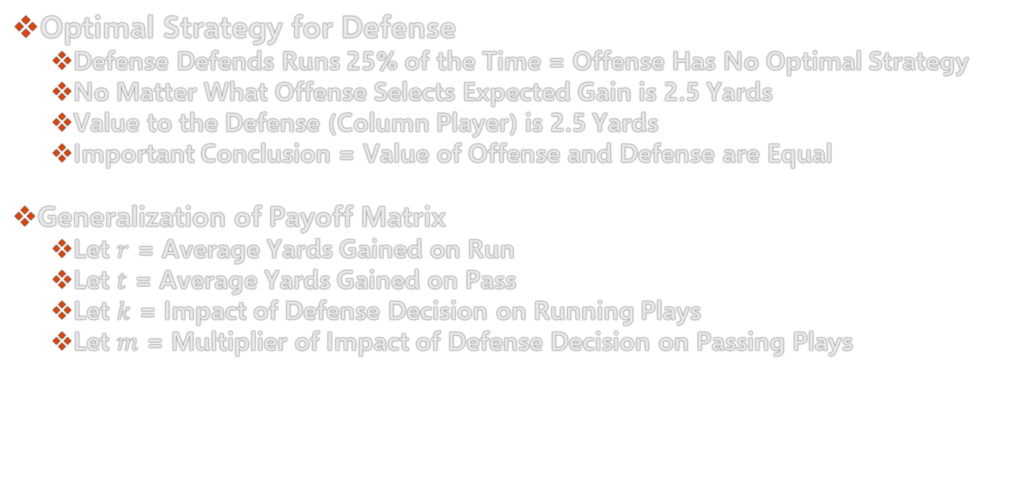
Why Don’t Teams Always Pass?
Optimal Strategy for Defense
Defense Defends Runs 25% of the Time = Offense Has No Optimal Strategy
No Matter What Offense Selects Expected Gain is 2.5 Yards
Value to the Defense (Column Player) is 2.5 Yards
Important Conclusion = Value of Offense and Defense are Equal
Generalization of Payoff Matrix
Let $r$ = Average Yards Gained on Run
Let $t$ = Average Yards Gained on Pass
Let $k$ = Impact of Defense Decision on Running Plays
Let $m$ = Multiplier of Impact of Defense Decision on Passing Plays

Slide 10
Why Don’t Teams Always Pass?
Generalization of Payoff Matrix
Visualization
Optimal Offensive Mix
Optimal Defensive Mix
 | Run Defense | Pass Defense
Offense Runs | r-k | r+k
Offense Passes | t+mk | t-mk
$$p=\frac{m}{m+1}$$
$$q=0.5+\frac{r−t}{2k(m+1)}$$
Defend Better Play More Than 50% of the Time

Slide 11
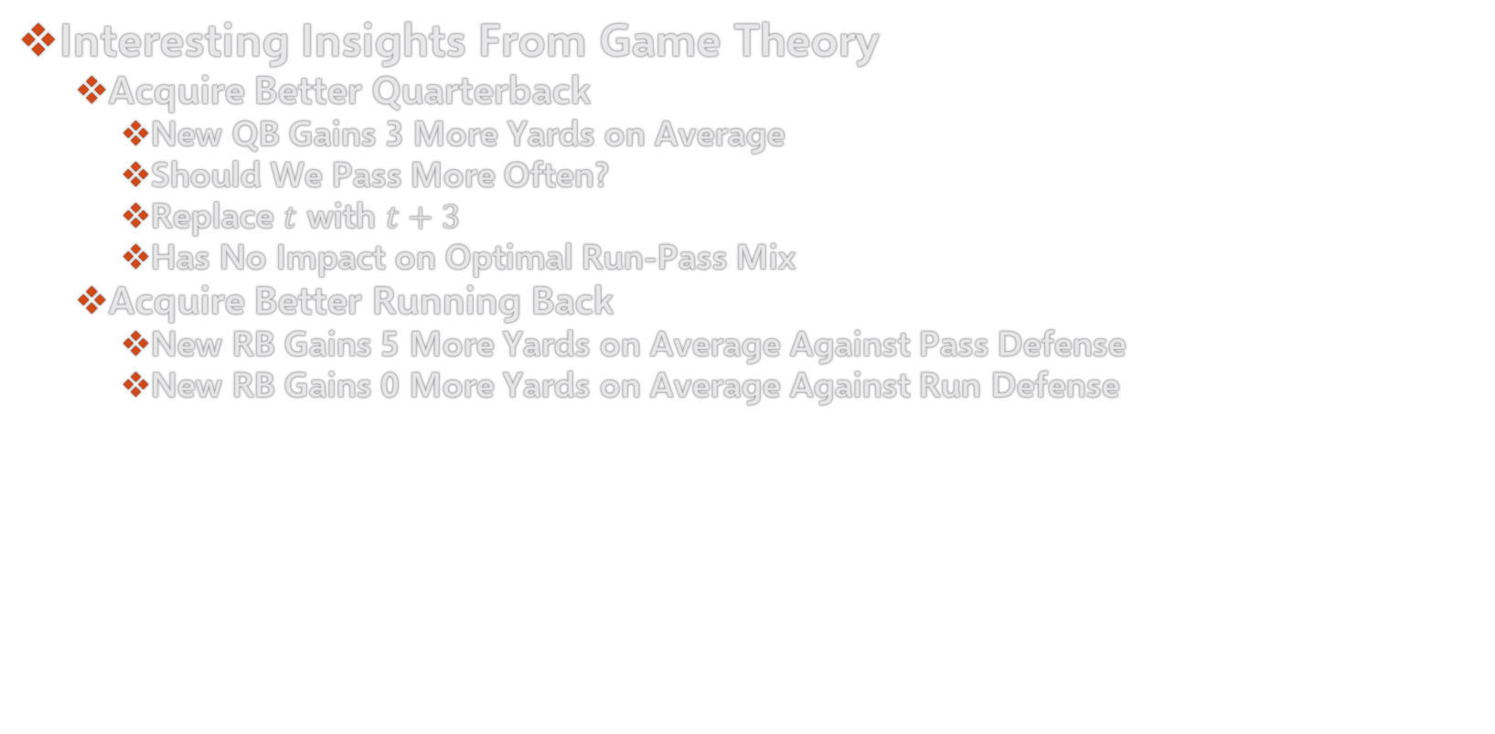
Why Don’t Teams Always Pass?
Interesting Insights From Game Theory
Acquire Better Quarterback
New QB Gains 3 More Yards on Average
Should We Pass More Often?
Replace $t$ with $t+3$
Has No Impact on Optimal Run-Pass Mix
Acquire Better Running Back
New RB Gains 5 More Yards on Average Against Pass Defense
New RB Gains 0 More Yards on Average Against Run Defense

Slide 12
Why Don’t Teams Always Pass?
Interesting Insights From Game Theory
Consider Payoff Matrix
Modified Payoff Matrix with Better Running Back
 | Run Defense | Pass Defense
Offense Runs | -5 | 5
Offense Passes | 5 | -5
 | Run Defense | Pass Defense
Offense Runs | -5 | 10
Offense Passes | 5 | -5

Slide 13
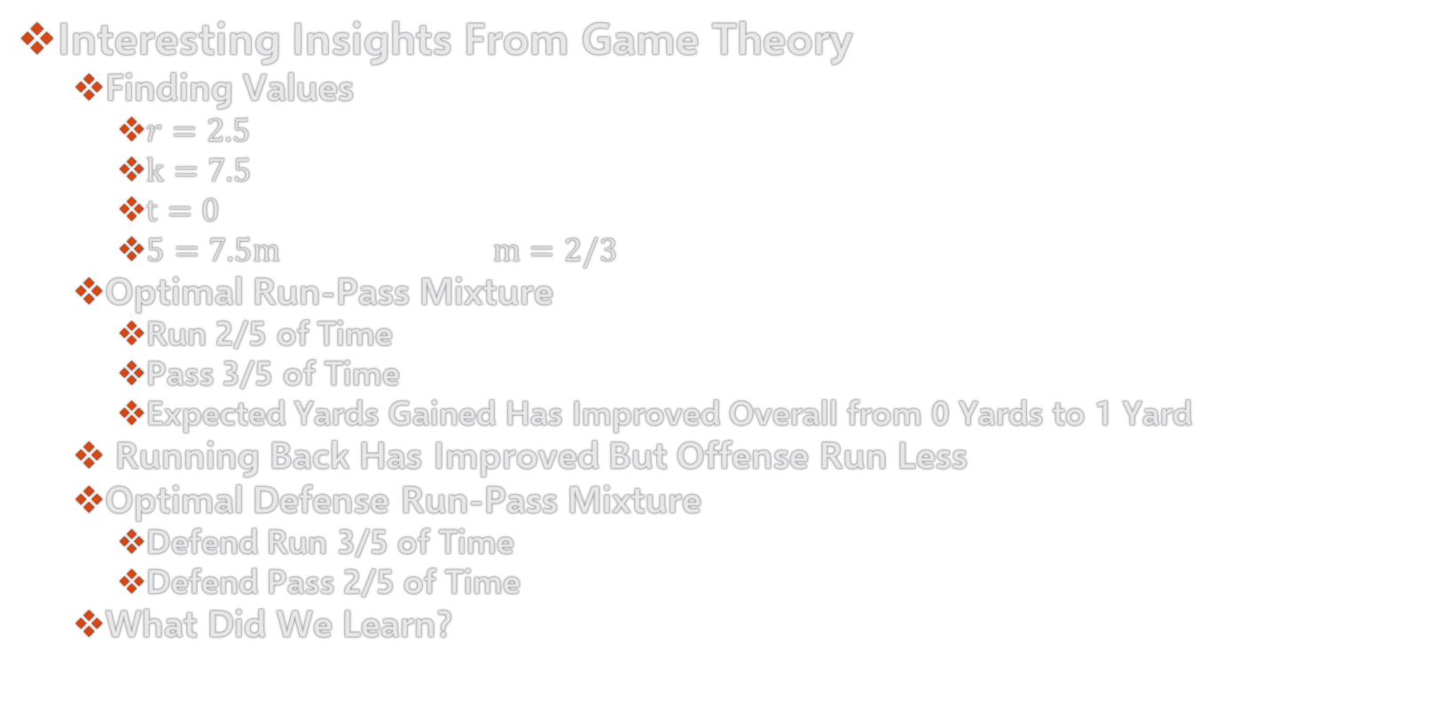
Why Don’t Teams Always Pass?
Interesting Insights From Game Theory
Finding Values
$r=2.5$
$k=7.5$
$t=0$
$5=7.5m$ $m=2/3$
Optimal Run-Pass Mixture
Run 2/5 of Time
Pass 3/5 of Time
Expected Yards Gained Has Improved Overall from 0 Yards to 1 Yard
Running Back Has Improved But Offense Run Less
Optimal Defense Run-Pass Mixture
Defend Run 3/5 of Time
Defend Pass 2/5 of Time
What Did We Learn?

Slide 14
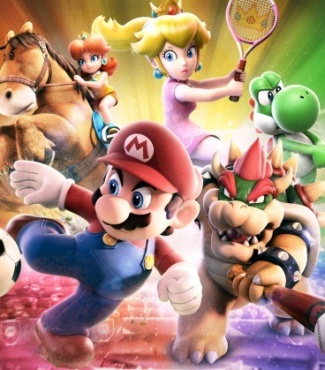
Final Inspiration
I’m just here so I can pay my fines.
- Mahatma Mario

